Slide 1
Introduction to Visual Storytelling
Housing Action Illinois

Slide 2
Marissa Diekhoff Communications & Development VISTA
Education
MA Photography & Urban Cultures Goldsmiths, University of London, 2016
BA International Human Rights & Photography
Webster University, 2015
Nonprofit Experience
Housing Action Illinois (2017, Chicago)
Story collection: interviews & photos
Communications/Marketing
Development
Fotosynthesis (2016, London)
Literacy Through Photography curriculum & workshops
River Styx & Gateway 180 Homeless Services (2015, St. Louis)
Photography for program promotion and grant proposals
StreetWise (2014, Chicago)
Story collection: interviews & photos
SportsWise podcast

Slide 3
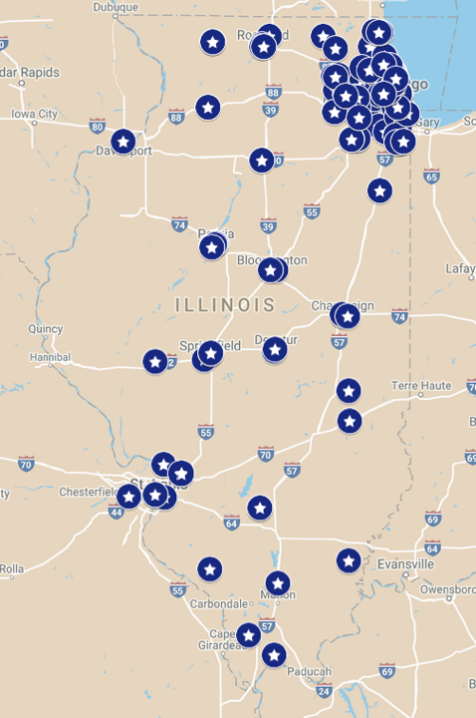
Housing Action Illinois
Housing Action Illinois
Everyone needs an affordable, stable place to call home.
That’s why we unite 160+ organizations across Illinois in protecting and expanding access to affordable housing.

Slide 4
Housing Action Illinois
Capacity Building
Policy Advocacy
Public Education & Organizing
HUD Intermediary
AmeriCorps VISTA Network

Slide 5
Overview
Introduction to Image-Making
Composing with Intention
Curating the Narrative

Slide 6
Introduction to image-making

Slide 7
Dan Hill, Emotionomics
“Humans are extremely visual: we think largely in images, not words. It’s important to be rationally on-message. But it’s even more imperative to be on-emotion.”
Notes:
Quote brings to fore two important points: we understand concepts and issues through images, and emotions are primary motivators for action and understanding… photographs can help

Slide 8
Ethics & Minimizing Harm
Adrienne Rich
Eastern War Time #9 (1991)
Streets closed, emptied by force Guns at corners with open mouths and eyes Memory speaks: You cannot live on me alone You cannot live without me I’m nothing if I’m just a roll of film stills from a vanished world fixed lightstreaked mute left for another generation’s restoration and framing I can’t be still I’m here in your mirror pressed leg to leg beside you intrusive inappropriate bitter flashing with what makes me unkillable though killed

Slide 9
Intentional Story Collection
Who is ready to tell their story?
Use your connections
Be patient, honest, and kind
How do they want to tell their story?
Ears first, camera second
Ask open questions
Let them lead you to what is important

Slide 10
Informed Consent
Always get consent when making or sharing an image where someone can be identified
Explicit vs. implicit consent
Give people an out
Release forms and reasonable understanding
Address: How? Where? When? Why?

Slide 11
Photographer Etiquette
Establish a dialogue & build rapport
Read the room
Plan your positions in advance
Keep an eye out for tension
Participate in the environment
Be discrete and respectful

Slide 12
Questions?

Slide 13
Composing with intention

Slide 14
Best Practices: Composition
Active observation & slow looking
Keep it simple & get close
Where do you want people to look?
Set the scene & pay attention to the background
What would help the viewer understand the story better?
Does my subject look comfortable?
Can I paint a wider picture?
Cultivate visual interest
Composition, shape, texture, color, pattern, etc.

Slide 15
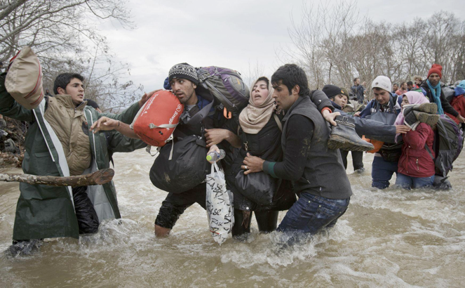
Lighting
Hard Light
Photo - Light Graph - To Write
Hard light: direct, high contrast, facial shadows, drama
Soft light: diffused, emphasizes details, most flattering, slower shutter speeds
Haikim Boulouiz, Santa Cruz de Tenerife (2017)
Winner: Street Single Image, Magnum Photography Awards
Soft Light
Vadim Ghirda, Migrant Crossing (2016)
Second Prize: Contemporary Issues, Singles; World Press Photo

Slide 16
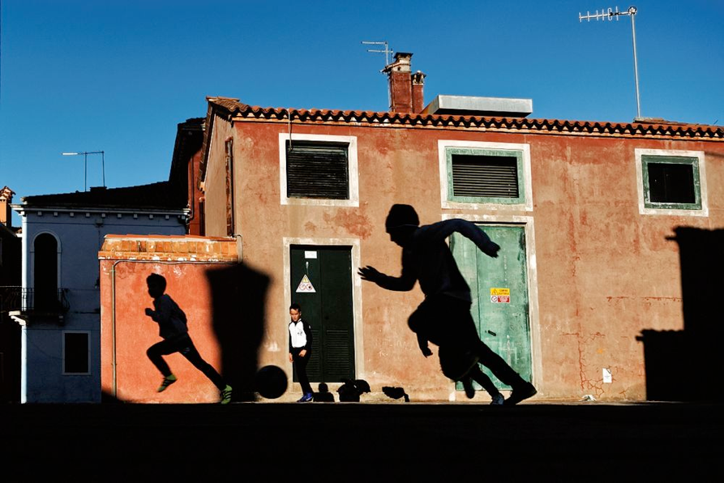
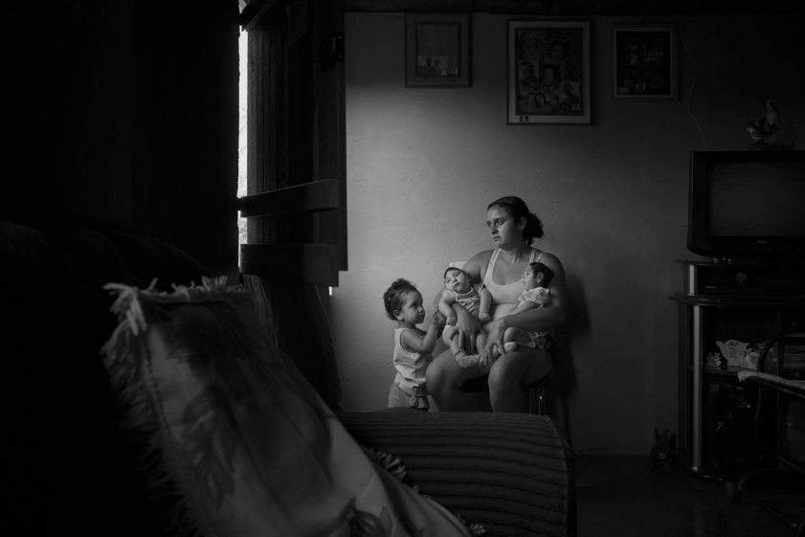
Mirko Saviane
B-Uranus (2017)
Juror’s Pick, Magnum Photography Awards
Vadim Ghirda
Victims of the Zika Virus (2016)
Second Prize: Contemporary Issues, Stories; World Press Photo

Slide 17
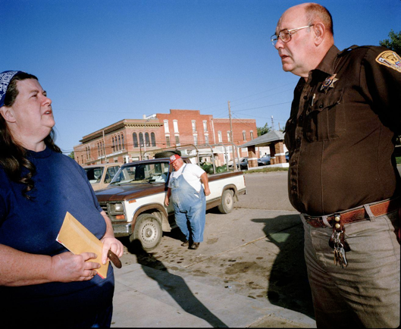
Perspective
What more (or less!) can you see from different angles?
How does the camera’s position impact how the viewer relates to the image?
Point of view impacts perception & distortion
Markus Jokela, Table Rock, Nebraska (2016)
Third Prize: Long-Term Projects, Stories; World Press Photo
Daniel Etter, The Libyan Migrant Trap (2016)
Third Prize: Contemporary Issues, Singles; World Press Photo

Slide 18
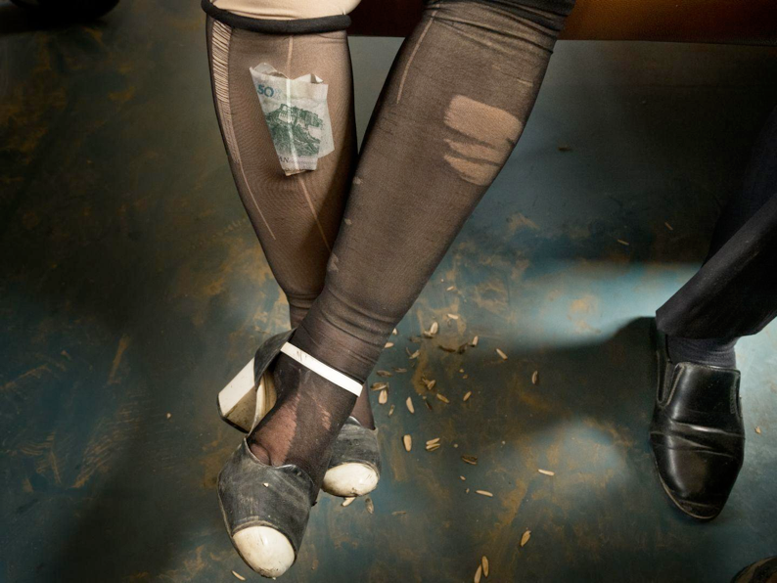
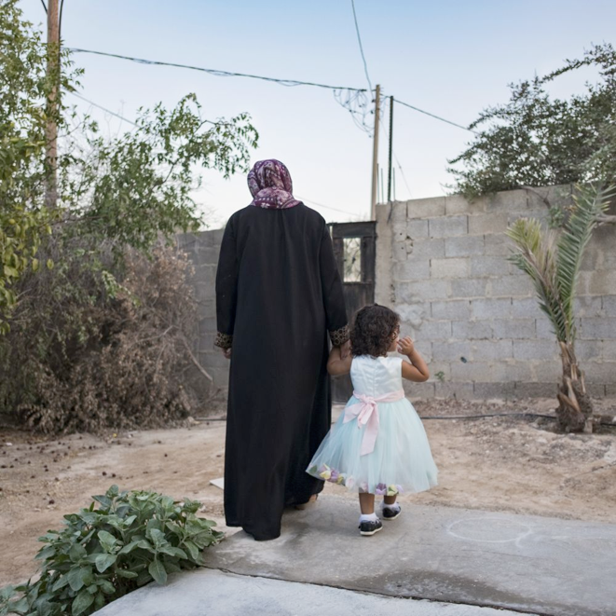
Antonio Faccilongo, Habibi (2016)
Finalist, Magnum Photography Awards
Matthieu Paley, China’s Wild West (2016)
Third Prize: Daily Life, Singles; World Press Photo

Slide 19
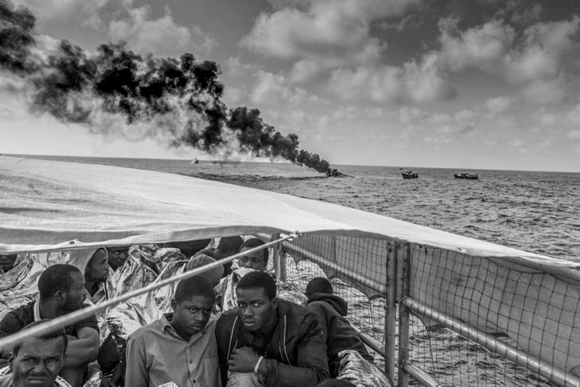
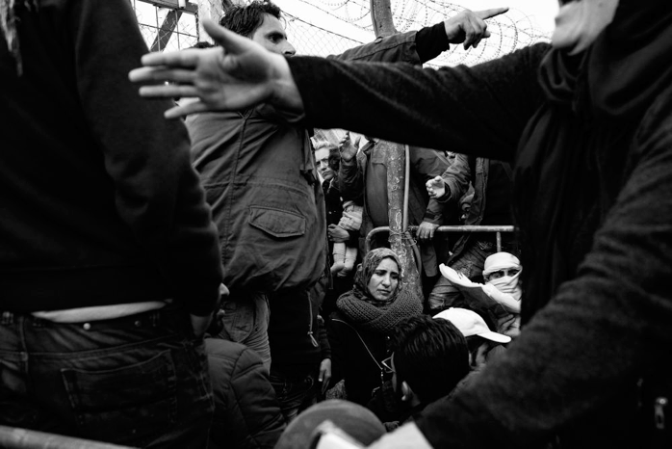
Framing (visually)
Use your environment to your advantage
How can you provide more context?
Jason Florio, Destination Europe (2017)
Winner: Photojournalism Series, Magnum Photography Awards
Szymon Barylski, Fleeing Death (2017)
Winner: Photojournalism Single Image, Magnum Photography Awards

Slide 20
Aesthetic Techniques
Leading Lines / Vanishing Point
Fill the Frame / Eye Level
Matthieu Paley, Cuba on the Edge of Change (2016)
First Prize: Daily Life, Stories; World Press Photo
Panos Kefalos, Saints (2016)
Finalist, Magnum Photography Awards

Slide 21
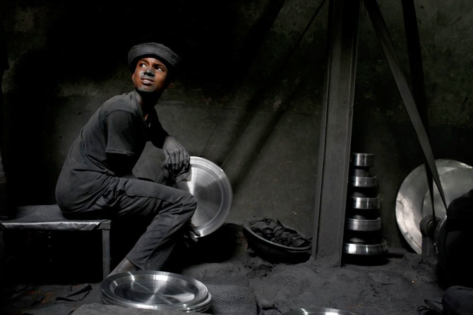
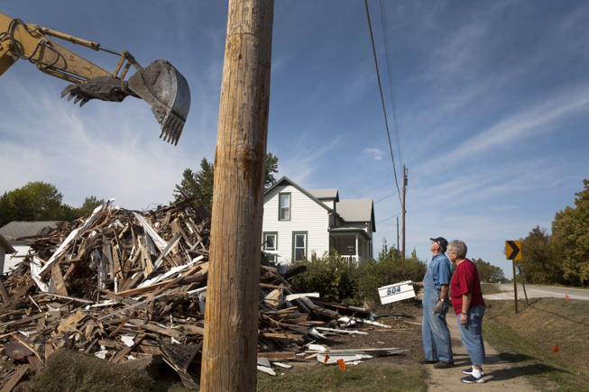
Rule of Thirds
Markus Jokela, Table Rock, Nebraska (2016)
Third Prize: Long-Term Projects, Stories; World Press Photo
Am Ahad, Childhood Covered in Dust (2016)
Finalist, Magnum Photography Awards

Slide 22
Questions?

Slide 23
Curating the narrative

Slide 24
What do you want to say?
Identify your communications goals
Audience: Who are you trying to reach?
Approach: What is your timeline? Platform? Context?
Action: What are you trying to get people to do?
Identify your barriers
What experience/opinion/perspective is preventing people from understanding the issue in the same way you do? How could you help them see it differently?
What actions might be difficult for someone to do?
Check your assumptions & relate
What is important to the audience?
What values do you share?

Slide 25
Storyboards & Shot Lists
Storyboards are perfect for inspiration, planning sequences, and mapping out an overarching narrative
Shot Lists are ideal for planning around specific events and organizing multiple photographers

Slide 26
A Photographer’s Workflow
Pre-visualize & Plan
Communications goals
Shot list/Storyboard
Toolkit
Photograph
Import, Cull, Rename & Organize
Edit & Export
Curate & Publish

Slide 27
Best Practices: Curating the Narrative
Be selective, relevant, & consistent
Consider: quality, size, color, composition, expression, etc.
Match visual vocabulary to messaging
Play to your target audience
Evoke familiar themes, metaphors, visual techniques
Pair images with text
Examples: quotes, facts, personal stories, Q&A, action alerts, research, captions, timestamps, etc.
Link to wider context & give clear solutions/actions

Slide 28
Examples
Single Image
Photo Story
Photos on the Web
Participatory Photography

Slide 29
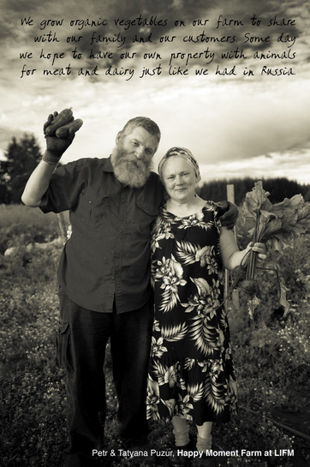
“Lents Grown” Story Yard, ROSE CDC
https://rosecdc.org/storyyard/
AARP

Slide 30
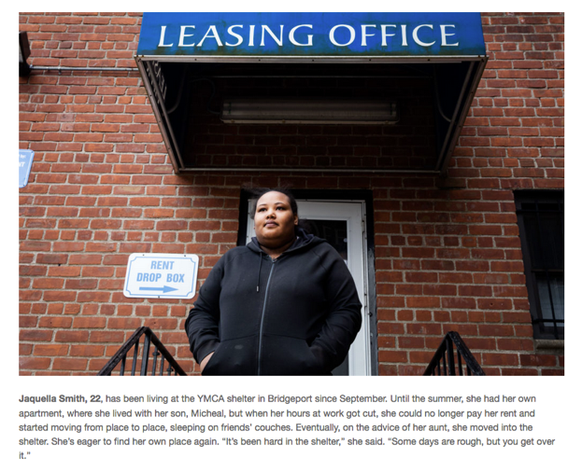
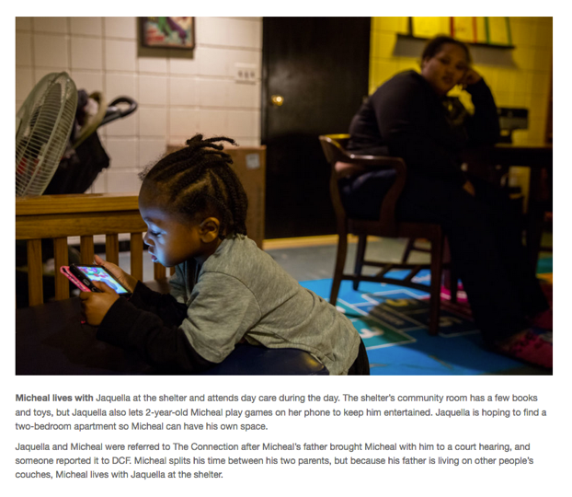
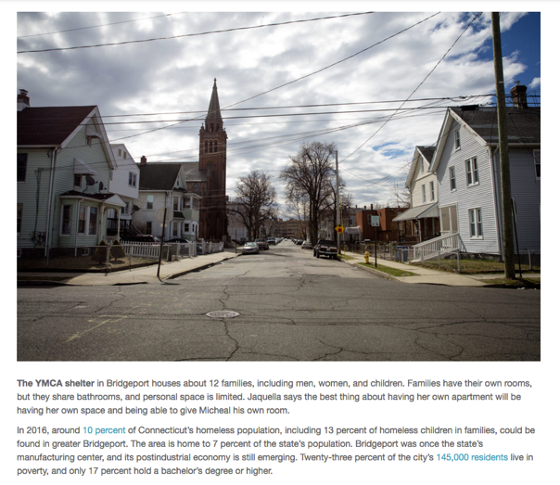
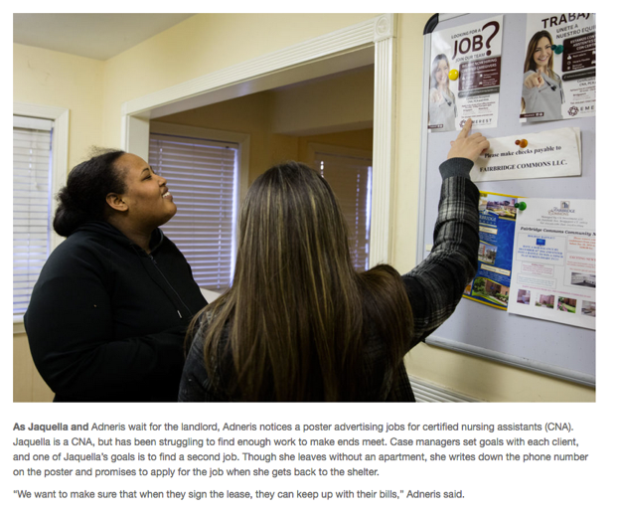
“Protecting Families: A Photo Story About Supportive Housing”
How Housing Matters

Slide 31
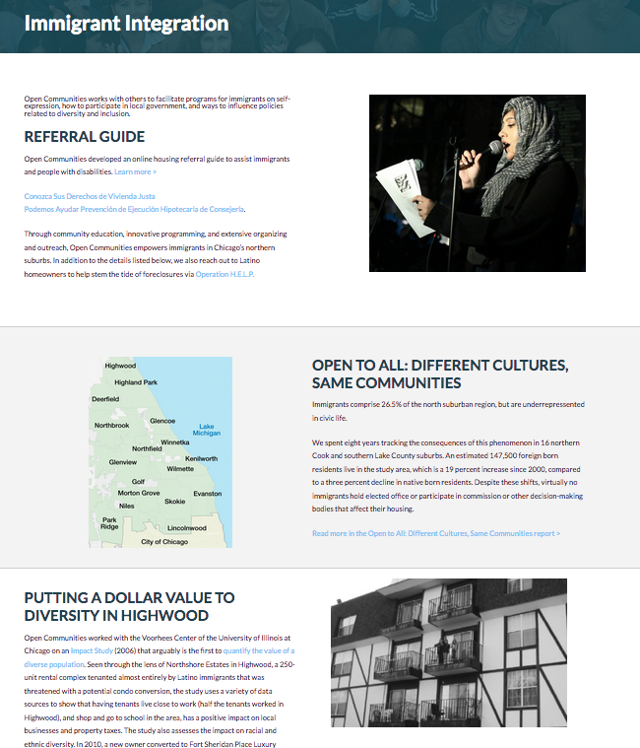
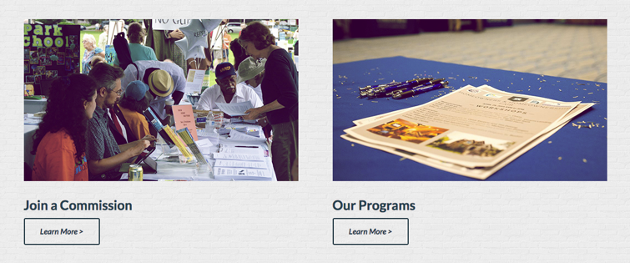
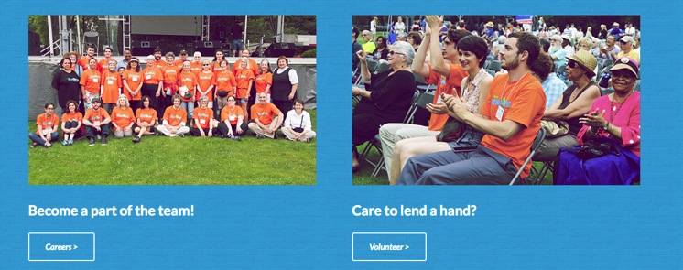
Open Communities
http://open-communities.org/

Slide 32
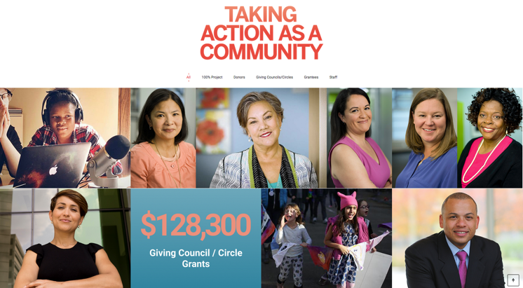
Chicago Foundation for Women
2017 Annual Report
http://takeaction.cfw.org/

Slide 33
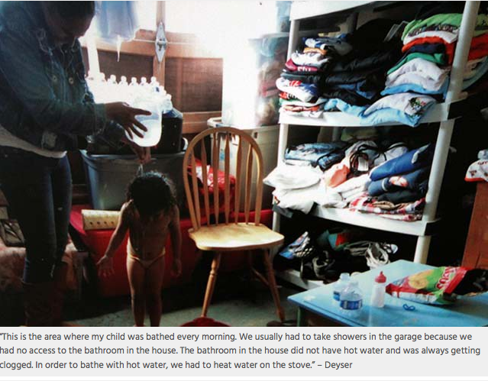
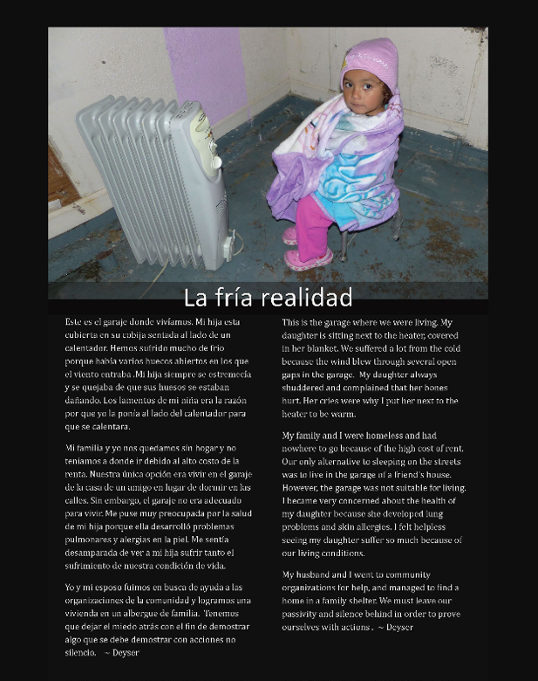
An American Dream?
Photo Voice Exhibition / Community Assessment for Safe & Affordable Housing (2016)
Mission Economic Development Association, Mission Promise Neighborhood Project, & San Francisco Department of Public Health
“This exhibit has allowed community researchers to provide a human context for the cold statistics used to describe San Francisco’s housing crisis. It has the potential to ground public dialogue about housing insecurity and its solutions more fully within the reality of peoples’ lived experiences.”

Slide 34
Questions?
Contact
Additional Materials
Marissa Diekhoff
marissa@housingactionil.org
312.939.6074 x109
mdiekhoffportfolio.com
Photography resources
Guide to digital cameras
Sample shot list

Slide 35
Discussion
NACEDA Photo Bank
Suzanne Gunther
Marissa Diekhoff

